Slide 1

University Institute of Engineering
DEPARTMENT OF COMPUTER SCIENCE & ENGINEERING
Bachelor of Engineering (Computer Science & Engineering)
Prepared by: Er Pooja Kaplesh
(Master Subject Coordinator)
Odd Semester- July-Dec, 2022
DISCOVER . LEARN . EMPOWER

Slide 2
University Vision
To be globally recognized as a Centre of Excellence for Research, Innovation, Entrepreneurship and disseminating knowledge by providing inspirational learning to produce professional leaders for serving the society

Slide 3
University Mission
Providing world class infrastructure, renowned academicians and ideal environment for Research, Innovation, Consultancy and Entrepreneurship relevant to the society.
Offering programs & courses in consonance with National policies for nation building and meeting global challenges.
Designing Curriculum to match International standards, needs of Industry, civil society and for inculcation of traits of Creative Thinking and Critical Analysis as well as Human and Ethical values.
Ensuring students delight by meeting their aspirations through blended learning, corporate mentoring, professional grooming, flexible curriculum and healthy atmosphere based on co-curricular and extra-curricular activities.

Slide 4
University Mission
Creating a scientific, transparent and objective examination/evaluation system to ensure an ideal certification.
Establishing strategic relationships with leading National and International corporate and universities for academic as well as research collaborations.
Contributing for creation of healthy, vibrant and sustainable society by involving in Institutional Social Responsibility (ISR) activities like rural development, welfare of senior citizens, women empowerment, community service, health and hygiene awareness and environmental protection

Slide 5
Department-Vision and Mission
Vision
To be recognized as a leading Computer Science and Engineering department through effective teaching practices and excellence in research and innovation for creating competent professionals with ethics, values and entrepreneurial attitude to deliver service to society and to meet the current industry standards at the global level.
Mission
M1: To provide practical knowledge using state-of-the-art technological support for the experiential learning of our students.
M2: To provide industry recommended curriculum and transparent assessment for quality learning experiences.
M3: To create global linkages for interdisciplinary collaborative learning and research.
M4: To nurture advanced learning platform for research and innovation for students’ profound future growth.
M5: To inculcate leadership qualities and strong ethical values through value based education.

Slide 6
PEO’s(Program Educational Objectives )
The statements of PEOs (revised from 2022) are given below:
PEO 1. Graduates of the Computer Science and Engineering can contribute to the Nation’s growth through their ability to solve diverse and complex computer science & engineering problems across a broad range of application areas.
PEO 2. Graduates of the Computer Science and Engineering can be successful professionals, designing and implementing Products & Services of global standards in the field of Computer Science & Engineering, becoming entrepreneurs, pursuing higher studies & research.
PEO 3. Graduates of the Computer Science and Engineering Program can be able to adapt to changing scenario of dynamic technology with an ability to solve larger societal problems using logical and flexible approach in decision making.

Slide 7
Program Outcomes (POs)
PO1: Engineering knowledge: Apply the knowledge of Mathematics, Science, Engineering fundamentals and computer science fundamental and strategies which have the solution of complex computer science engineering problems.
PO2: Problem analysis: Identify, formulate, research literature, and analyze complex computer science engineering problems reaching substantiated conclusions using first principles of mathematics, natural sciences, and engineering sciences.
PO3: Design/development of solutions: Design solutions for complex database and software engineering problems and design system components or processes that meet the specified needs with appropriate considerations for the public health and safety, and the cultural, societal, and environmental considerations.

Slide 8
Program Outcomes (POs)
PO4: Conduct investigations of complex problems: Use research-based knowledge and research methods including design of software engineering & networking based experiments, analysis and Interpretation of data, and synthesis of the information to provide valid conclusions.
PO5: Modern tool usage: Create, select, and apply appropriate techniques, resources, and modern Computer science engineering and IT tools including prediction and modeling to complex database or software engineering activities with an understanding of the limitations.
PO6: The engineer and society: Apply reasoning informed by the contextual knowledge to assess social, health, safety, legal and cultural issues and the consequent responsibilities relevant to the Professional Computer Science & Engineering practice.

Slide 9
Program Outcomes (POs)
PO7: Environment and sustainability: Understand the impact of the professional computer science and engineering solutions in social and environmental contexts, and demonstrate the knowledge of, and need for sustainable development goals.
PO8: Ethics: Apply ethical principles and commit to professional ethics and responsibilities and norms of computer science engineering practice
PO9: Individual and team work: Function effectively as an individual, and as a member or leader in diverse teams, and in multidisciplinary settings.

Slide 10
Program Outcomes (POs)
PO10: Communication: Communicate effectively on complex computer science engineering activities with the engineering community like CSI society at large, such as, being able to comprehend and write effective reports and design documentation, make effective presentations, and give and receive clear instructions.
PO11: Project management and finance: Demonstrate knowledge and understanding of the computer science engineering and management principles and apply these to one’s own work, as a member and leader in a team, to manage projects and in multidisciplinary environments.
PO12: Life-long learning: Recognize the need for, and have the preparation and ability to engage in independent and life- long learning in the broadest context of computer science engineering changes

Slide 11
Program Specific Outcomes (PSOs)
A Graduate of Computer Science and Engineering Program will be able:
PSO1. To acquire proficiency in developing and implementing efficient solutions using emerging technologies, platforms and Free and Open-Source Software (FOSS).
PSO2. To gain critical understanding of hardware and software tools catering to the contemporary needs of IT industry.

Slide 12
Course Objectives
Web and Mobile Security
20CST-333/CSP-338
To understand the basic concepts of web server architecture and protocols
To learn basic security techniques used in web and mobile architecture
To understand threats impact and mitigations in web security
To design basic mobile applications along with graphical features
To learn various tools and techniques likely to face the domain of ethical hacking and ethical responsibilities

Slide 13
Course Outcomes
1. Understand the modern concept and foundation of web and Mobile security
2. Familiarize with the issues and technologies involved in designing a wireless and mobile system that is robust against various attacks
3. Identify network vulnerability, emphasis on ethics, social engineering vulnerabilities and training
4. Understand principles of web security and to guarantee a secure network by monitoring and analyzing the nature of attacks through cyber/computer forensics software/tools
5. To gain knowledge of the tools, techniques and ethical issues likely to face the domain of ethical hacking and ethical responsibilities

Slide 14
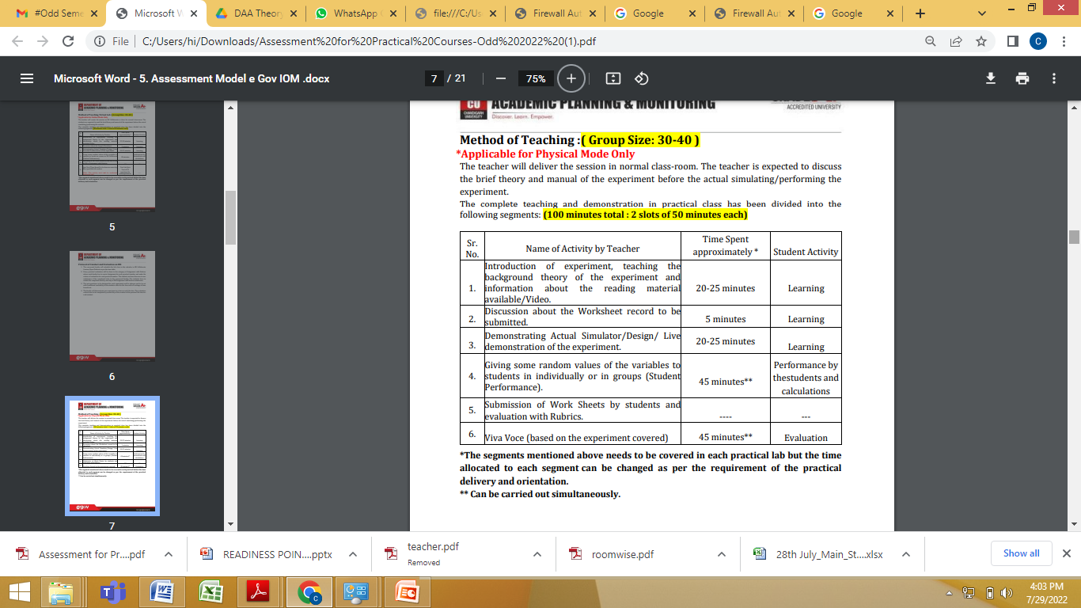
Method of Teaching

Slide 15
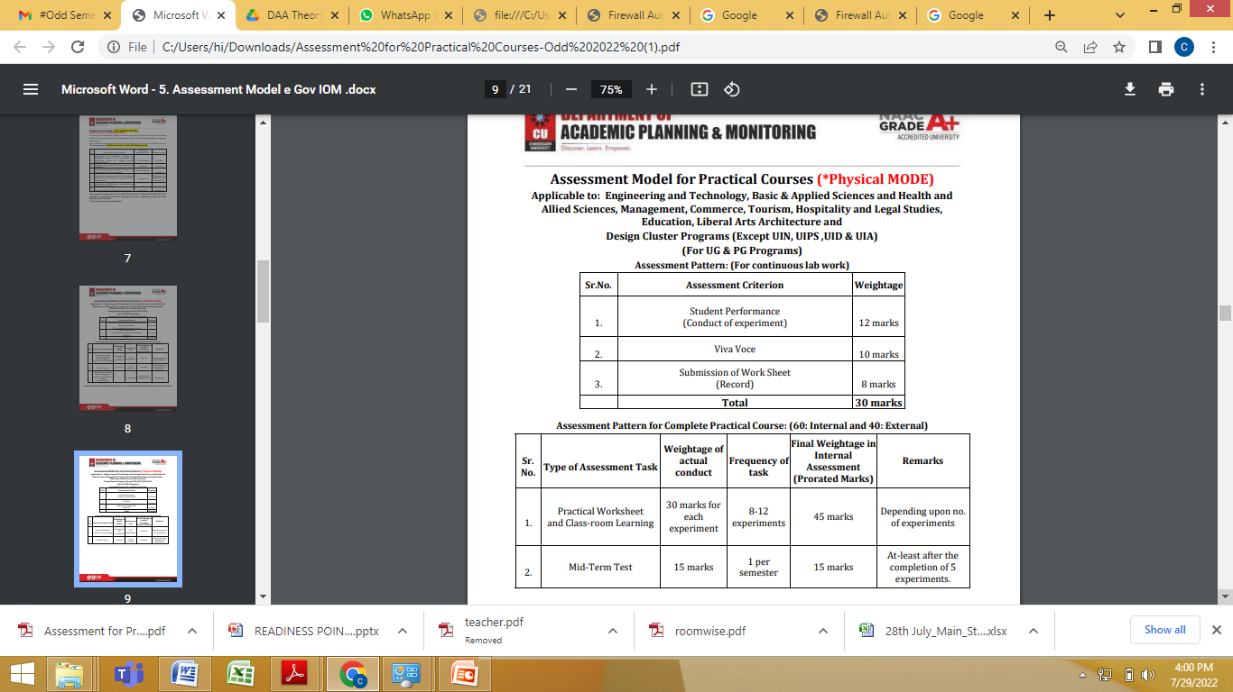
Assessment Model(Lab)

Slide 16
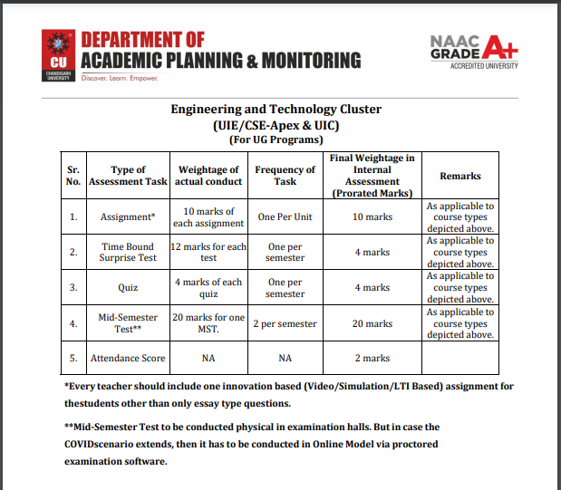
Assessment Model(Theory)

Slide 17
Syllabus(Theory)
Syllabus
Unit-1 | Web Architecture and Mobile Security Fundamentals
Ch-1.1 | Web Fundamentals – HTML, HTTP, Client-side scripting, Server-side scripting.
Ch-1.2 | Web server architecture - Windows & Linux, IIS and LAMP servers, Network topologies and DMZ.
Ch-1.3 | Mobile Security Fundamentals- Introduction to Mobile Security, Building Blocks – Basic security and cryptographic techniques.
Unit-2 | Security Models, Attacks and Countermeasures
Ch-2.1 | Web applications: Introduction to web applications, Web application hacking, Overview of browsers, extensions, and platforms. Mobile applications and Models: Mobile Malware and App Security, Android Security Model , IOS Security Model , Security Model of the Windows Phone
Ch-2.2 | Web Security-Attacks, detection evasion techniques, and countermeasures for the most popular web platforms, including IIS, Apache, PHP, and ASP.NET Attacks and countermeasures for common web authentication mechanisms, including password-based, multifactor (e.g., CAPTCHA), and online authentication services like Windows Live ID.
Ch-2.3 | Mobile Security-Security of GSM Networks, Security of UMTS Networks, LTE Security, Wi-Fi and Bluetooth Security, SIM/UICC Security.

Slide 18
Unit-3 | Advanced Security and Ethical Hacking Concepts
Ch-3.1 | Advanced session analysis, hijacking, and fixation techniques, cross-site scripting, SQL injection, classic categories of malicious input, Overlong input (like buffer overflows), canonicalization attacks (like the infamous dot-dot-slash), and meta characters (including angle brackets, quotes, single quote, double dashes, percent, asterisk, underscore, newline, ampersand, pipe, and semicolon), beginner-to-advanced SQL injection tools and techniques, stealth-encoding techniques and input validation/ output-encoding countermeasures.
Ch-3.2 | Emerging Trends in Mobile Security-Mobile Geo-location and Mobile Web Security, Security of Mobile VoIP Communications.
Ch-3.3 | Web services vulnerabilities discovery and XSS Attack, input injection, external entity injection, and XPath injection. Web application management attacks against remote server management, web content management/authoring, admin misconfigurations, and developer-driven mistakes. Web browser exploits.

Slide 19
Textbooks Books
Hacking Exposed Web Applications, 3rd edition, Joel Scambray, Vincent Liu, Caleb Sima
Hacking Exposed Mobile: Security Secrets & Solutions 1st Edition, Kindle Edition, by Neil Bergman, Mike Stanfield, Jason Rouse, and Joel Scambray
Reference Books
The Web Application Hacker's Handbook Discovering and Exploiting Security Flaws By Dafydd Stuttard, Marcus Pinto, Published by Wiley Publishing, Inc.
Web Application Security, Exploitation and Countermeasures for Modern Web Applications by Andrew Hoffman, Publisher(s): O'Reilly Media, Inc.
Pallapa Venkataram, Satish Babu: “Wireless and Mobile Network Security”, 1st Edition, Tata McGraw Hill,2010.
Open Web Application Security Project. A Guide to Building Secure Web Applications and Web Services. http://www.owasp.org/index.php/Category:OWASP_Guide_Project

Slide 20
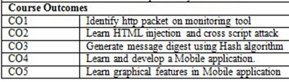
List of Experiments
Experiment No | Experiment Name | Mapped with CO
1 | Open any website on computer system and identify http packet on monitoring tool like Wireshark. | CO1
2 | Design a method to simulate the HTML injections and cross-site scripting (XSS) to exploit the attackers. | CO2
3 | Implementation of Cross site request forgery (XSRF) attack. | CO2
4 | Implementation of Design methods to break authentication schemes (SQL Injection attack). | CO2
5 | Write a program to generate message digest for the given message using the SHA/MD5 algorithm and verify the integrity of message. | CO3
6 | Perform Penetration testing on a web application to gather information about the system (Foot Printing). | CO2
7 | Implementation of Session hijacking attack on http enabled website. | CO2
8 | Write a program to sign and verify a document using DSA algorithm. | CO3
9 | Develop a Mobile application to create a notification in Android. | CO4
10 | Create animations and graphical primitives in Android environment. | CO5

Slide 21
Importance of Subject
Many businesses have moved online and as a result web application security is now more crucial than ever. The global nature of the internet exposes applications and websites to external attacks by hackers. Securing web application has become more important.
Web security is important to keeping hackers and cyber-thieves from accessing sensitive information. Without security, businesses risk the spread of malware, attacks on other websites, networks, and other IT infrastructures.
Reducing the risk of data breaches and attacks in IT systems. Applying security controls to prevent unauthorized access to sensitive information. Preventing disruption of services, e.g., denial-of-service attacks. Protecting IT systems and networks from exploitation by outsiders.

Slide 22
Importance of Subject
Mobile security prevents your phone from becoming vulnerable to malware.
Mobile security provides constant mobile patching services.
In any cybersecurity strategy, software patching plays a crucial role. Software updates mostly include software patches that are responsible for covering security holes to keep hackers out.
Mobile security protects your private data.
Mobile security protects you against malvertisers.

Slide 23
Top Web Security Trends
1.) Rise of Automotive Hacking
Modern vehicles nowadays come packed with automated software creating seamless connectivity for drivers in cruise control, engine timing, door lock, airbags and advanced systems for driver assistance. These vehicles use Bluetooth and WiFi technologies to communicate that also opens them to several vulnerabilities or threats from hackers. Gaining control of the vehicle or using microphones for eavesdropping is expected to rise in 2022 with more use of automated vehicles.
2.) Potential of Artificial Intelligence (AI)
With AI being introduced in all market segments, this technology with a combination of machine learning has brought tremendous changes in cybersecurity. AI has been paramount in building automated security systems, natural language processing, face detection, and automatic threat detection. Although, it is also being used to develop smart malware and attacks to bypass the latest security protocols in controlling data. AI enabled threat detection systems can predict new attacks and notify admins for any data breach instantly.

Slide 24
3) Mobile is the New Target
Cybersecurity trends provide a considerable increase (50 percent) for mobile banking malware or attacks in 2019, making our handheld devices a potential prospect for hackers. All our photos, financial transactions, emails, and messages possess more threats to individuals. Smartphone's virus or malware may capture the attention of cybersecurity trends in 2022.
4) Cloud is Also Potentially Vulnerable
With more and more organizations now established on clouds, security measures need to be continuously monitored and updated to safeguard the data from leaks. Although cloud applications such as Google or Microsoft are well equipped with security from their end still, it's the user end that acts as a significant source for erroneous errors, malicious software, and phishing attacks.

Slide 25
5) IoT with 5G Network: The New Era of Technology and Risks
This communication between multiple devices also opens them to vulnerabilities from outside influence, attacks or an unknown software bug. Even the world's most used browser supported by Google, Chrome was found to have serious bugs. 5G architecture is comparatively new in the industry and requires a lot of research to find loopholes to make the system secure from external attack. Every step of the 5G network might bring a plethora of network attacks that we might not be aware of. Here manufacturers need to be very strict in building sophisticated 5G hardware and software to control data breaches.
6) Insider Threats
Human error is still one of the primary reasons for the data breach. Any bad day or intentional loophole can bring down a whole organization with millions of stolen data. Report by Verizon in data breach gives strategic insights on cybersecurity trends that 34 percent of total attacks were directly or indirectly made by the employees. So make sure you create more awareness within premises to safeguard data in every way possible.
Refer the link: https://www.simplilearn.com/top-cybersecurity-trends-article

Slide 26
Target Companies
HCL Technologies Ltd.
FICO India Pvt. Ltd. (Fair Isaac India Pvt. Ltd)
Tata Elxsi Limited
Resec Systems Pvt. Ltd
Infinite Computer Solutions
KPMG Global Services Private Limited
Birla Soft India Ltd

Slide 27
THANK YOU

